Slide 1
Object Oriented Analysis and Design
Class Diagrams and Object Diagrams

Slide 2
Class
Collection of group of things that have the same attributes and the same behaviors

Slide 3
Class Diagram
Class diagram describes the types of objects in the system and the various kinds of static relationships that exist among them.
It also shows the attributes and services of a class and the constraints that apply to the way objects are connected.

Slide 4
Class
Stereotype:
Type of the Class;
entity for Analysis.
<<entity>>
Name of the Class
Patient
-name : CHAR
Attributes of the
Class
-dateOfBirth: DATE
Operations of the
Class
+getName ()

Slide 5
Major Components
<<entity>>
<<entity>>
Patient
Class:
With 3
Compartments
Inheritance
Association
Doctor
Class
Description
Contains
Attributes
&
Operations
Multiplicity
At each end
Of Association
Notes
-
-
DoctorID
:
:
Qual
[
[
0
0
..
..
N
N
]
]
+
+
getDoctorDtls
(
(
)
)
1
..
N
0
N

Slide 6
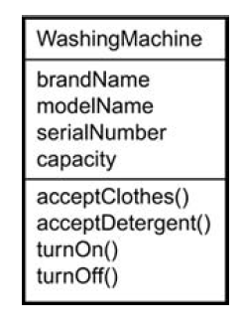
Class Diagram
Name
All words start in capital
No spaces
List of attributes
No capitals in first word
All other words only start with capital
No space
List of methods
No capitals in first word
All other words only start with capital
No space
Parentheses at the end

Slide 7
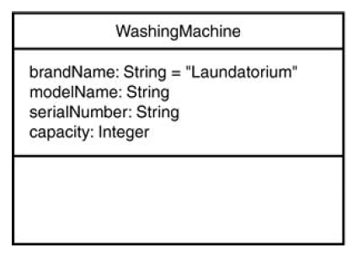
Class Diagram
Indicating data type and default value

Slide 8
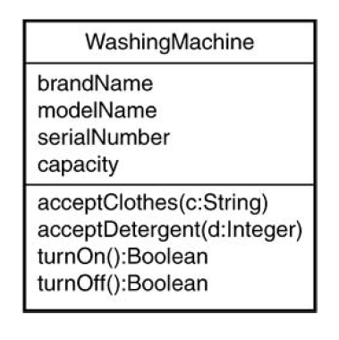
Class Diagram
Function signature
acceptCloths(c:String)int
Function name acceptCloths
Parameter : String type c
Return value :type is int

Slide 9
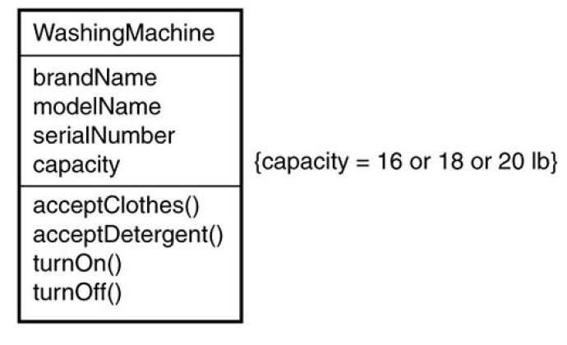
Class Diagram
Including constraints

Slide 10
Visibility
+ Public
‐ Private
# Protected
~ Package

Slide 11
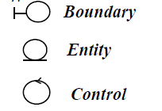
Stereotypes and Classes
A Stereotype is a mechanism use to categorize classes.
Primary class stereotypes in UML

Slide 12
Boundary Classes
Provide the interface to a user or another system.
Handles communication between system surroundings and the inside of the system
User interface classes
System interface classes
Device interface classes

Slide 13
Entity Classes
Fundamental building block which perform internal tasks
Represent real world entity
They correspond to database table

Slide 14
Control Classes
Objects that mediate between boundaries and entities.
Typically one control class per use case

Slide 15
Relationships
Association
Aggregation/Composition
Generalization/Inheritance
Dependency

Slide 16
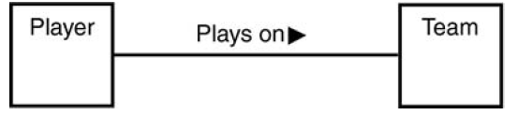
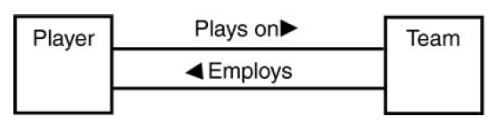
Associations
Link between classes

Slide 17
Multiplicity
Type of relationship
The number of objects from one class that relate with a single object in an associated class
1 Exactly one
0..* Zero or more
1..* One or more
0..1 Zero or one
5..8 Specific Range (5,6,7 or 8)

Slide 18
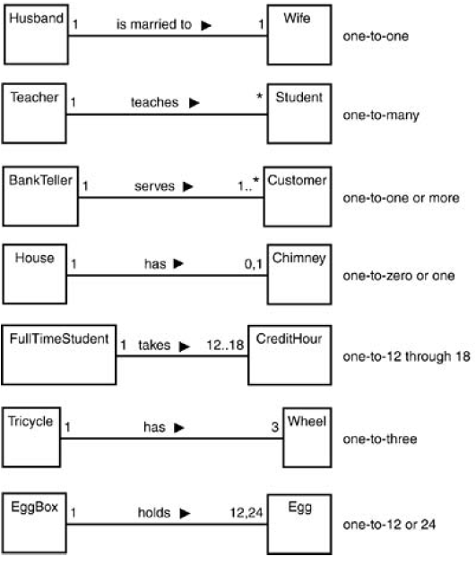
Class Diagram
Multiplicity

Slide 19
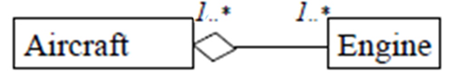
Aggregation (Shared Association)
Relationship between whole and it’ part
Containing class with a diamonded single line and contained class

Slide 20
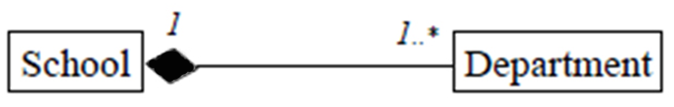
Composition(Not-Shared Association)
Stronger type aggregation
Each component in a composite can belong to just only one whole
Child class's instance lifecycle is dependent on the parent class's instance lifecycle.

Slide 21
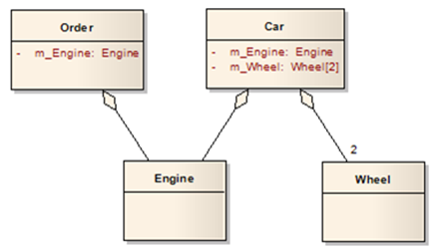
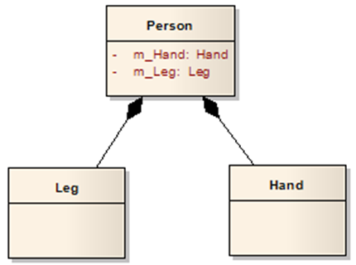
Aggregation Vs. Composition

Slide 22
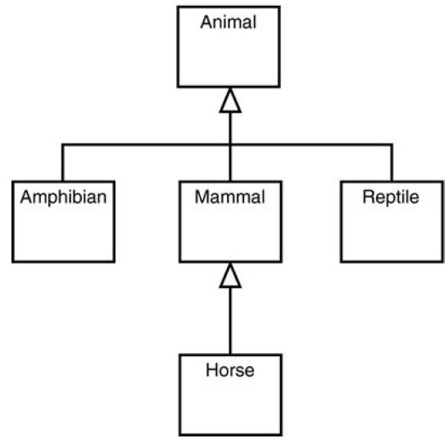
Inheritance
Base class or root class.
No parents
leaf class
No children
Single inheritance
Single parent
Multiple inheritance
More than one parent

Slide 23
Inheritance
Create hierarchy of classes
Classes at the top of hierarchy known as super class
Super classes holding the common information
Sub classes inherit all the features of super classes

Slide 24
Generalization/ Specialization
Generalization
Create super class encapsulate structure and behavior common to number of classes
Specialization
Create sub class that represent refinement to super class.
Specific structure and behavior are added to sub classes

Slide 25
Generalization/ Specialization
Finding Super classes
Needs abstract thinking
Domain knowledge helpful
Helps in creating reusable Classes
Finding Subclasses
Concrete lower level implementation thinking
Helps in using reusable Classes
Generalization
Specialization

Slide 26
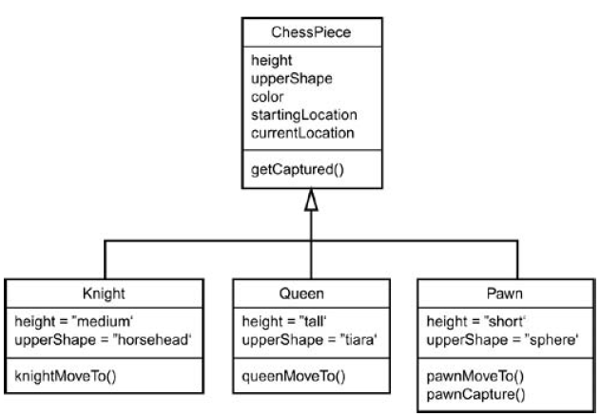
Example

Slide 27
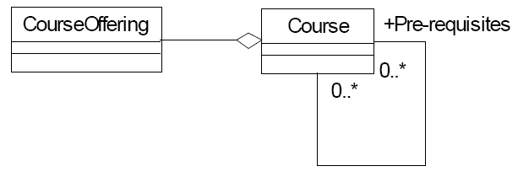
Reflexive Relations
Relationship of a class to itself
Possible when a class has objects that can play a variety of roles

Slide 28
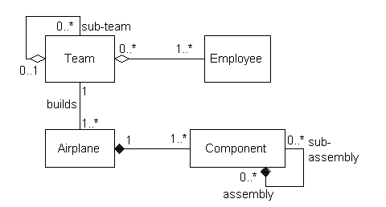
Example

Slide 29
Object Diagram
Object diagram is an instance of a class diagram; it shows a snapshot of the detailed state of a system at a point in time

Slide 30
Object Diagram
Also known as instance diagrams
Useful for exploring real world examples of objects and the relationships between them.
It shows instances instead of classes.
They are useful for explaining small pieces with complicated relationships

Slide 31
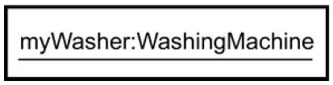
Object Diagram
Object diagram specify object name and values of the class attributes
Name is underlined
Name stars with simple letter
Only first letter of other words are Capital
instanceName:ClassName
Object notation
Example

Slide 32
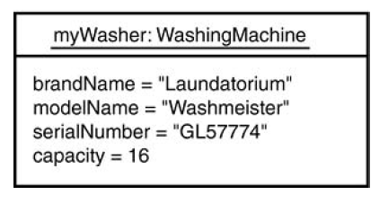
Object Diagram
Specifying values of attributes

Slide 33

Object Diagram
Anonymous object
Just means that don't supply a specific name for the object, although show the class it belongs to.

Slide 34
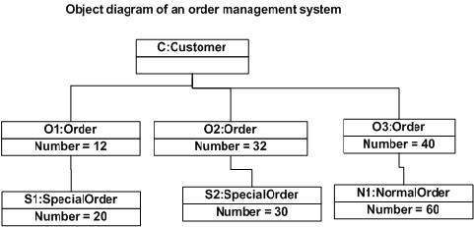
Object Diagram Example

